Slide 1
3D Slicer Segmentation basics
Andras Lasso

Slide 2
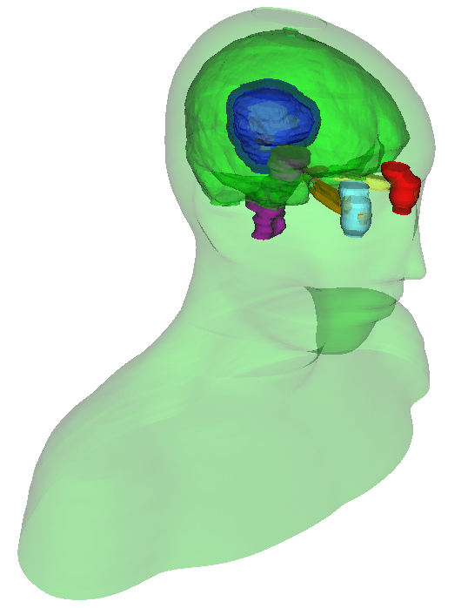
Segmentation
Also known as contouring
Delineates structures of interest
Manual contouring: Slice by slice
Automatic / semi-automatic
Omnipresent in medical imaging
Surgical/radiation therapy planning
Intra-surgery navigation
Volume/shape analysis
3D printing (interventions)
Education
Head and neck RT phantom case

Slide 3
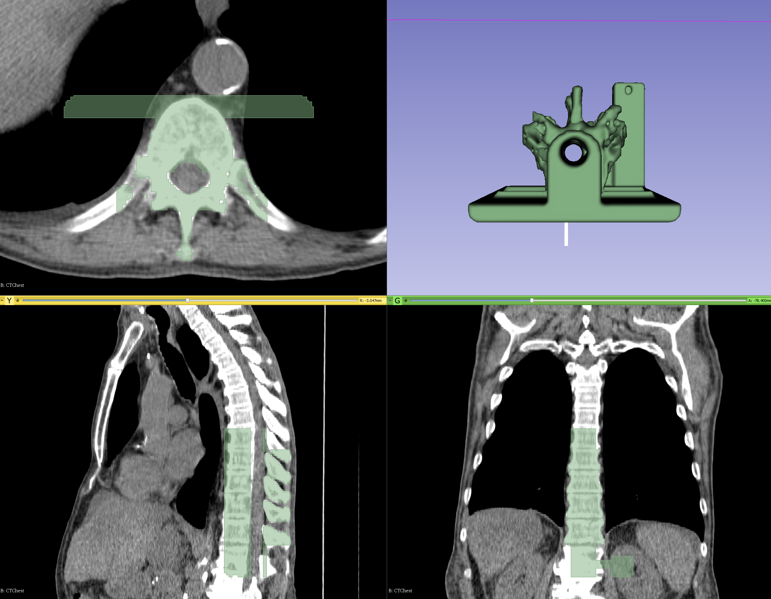
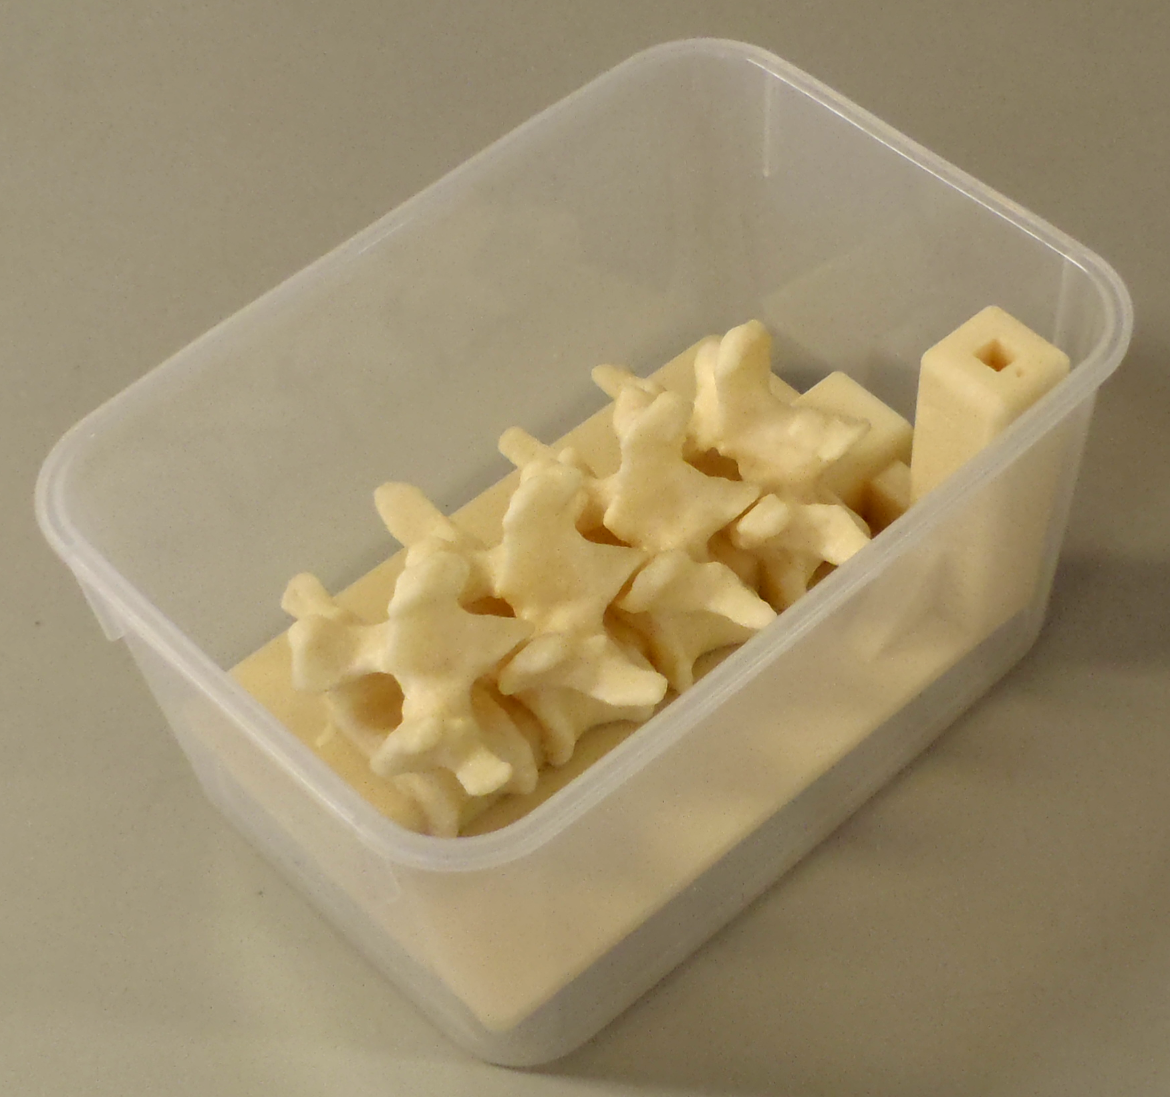
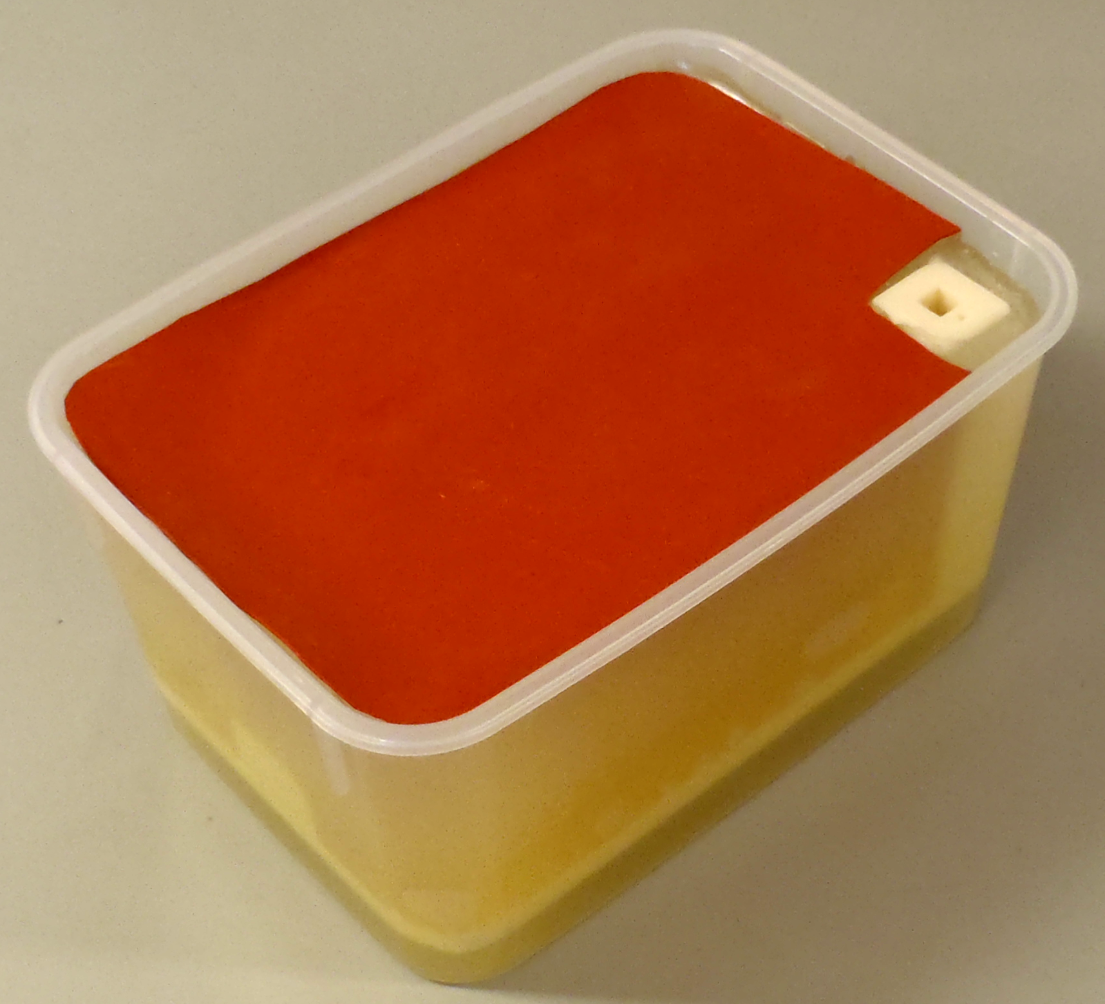
Segmentation
Manual (paint, draw, scissor, threshold, etc.)
Semi-automatic (region-growing, fill between slices, etc.)
Automatic (atlas-based, robust statistics, etc.)
Notes:
As for the common task of segmentation (which means to divide an image into multiple parts which is typically used to identify objects), Slicer supports both manual approaches (like contouring and painting) as well as automatic (like region-growing and atlas-based).
The Slicer screenshot here shows a segmented prostate in the Editor module where many of these tasks can be performed.

Slide 4
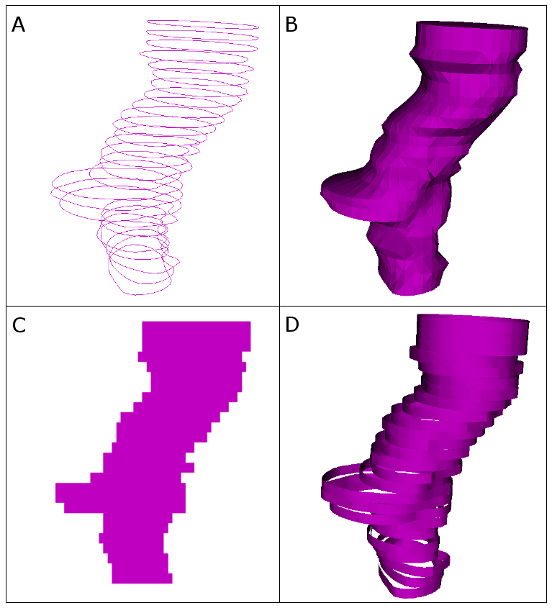
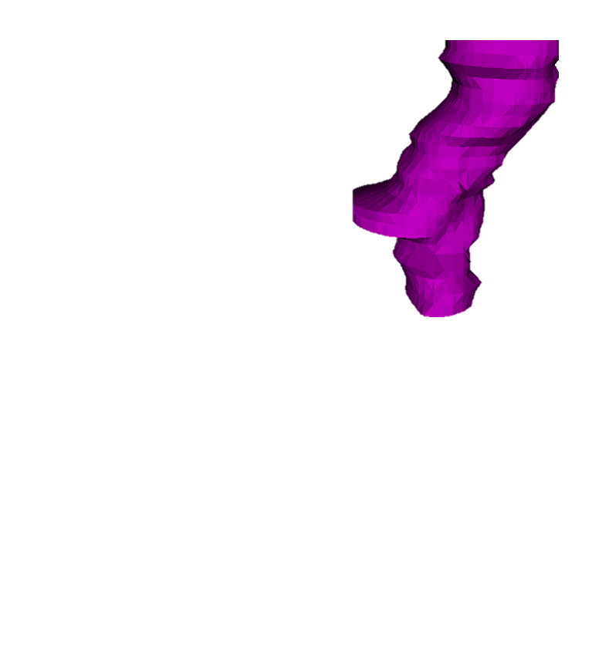

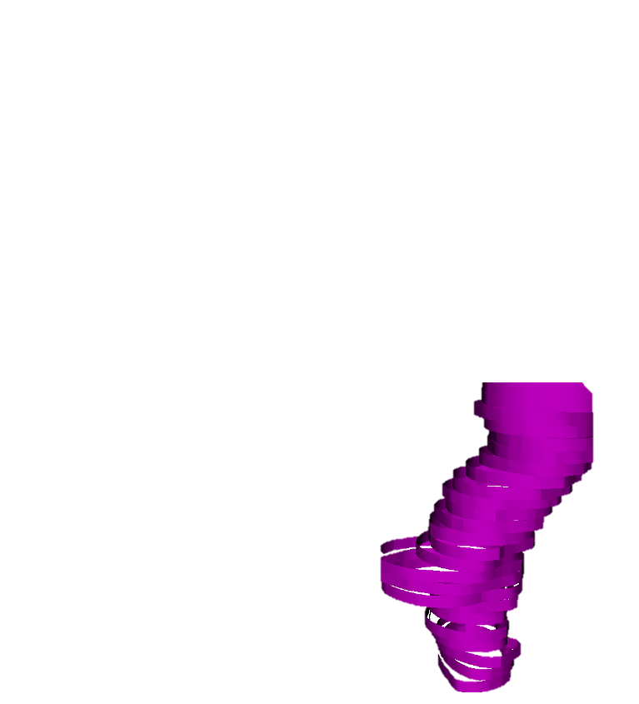
Representations
Binary labelmap
+ Easy 2D viewing and editing
+ Robust (always valid, even if transformed or edited)
- Inaccurate (finite resolution)
- Requires lots of memory if overlap allowed
Closed surface
+ Easy 3D visualization
- Difficult to edit
- May be invalid (e.g., self-intersecting), especially after non-linear transformation
Fractional labelmap
+ Quite easy 2D viewing and editing
+ Robust
- Quite Accurate
- Requires lots of memory
Planar contours, Ribbons
+ Accurate 2D viewing and editing
- Ambiguous in 3D
- Poor 3D visualization

Slide 5

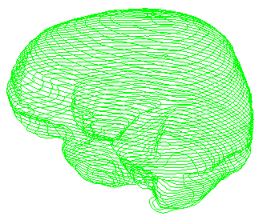
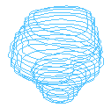


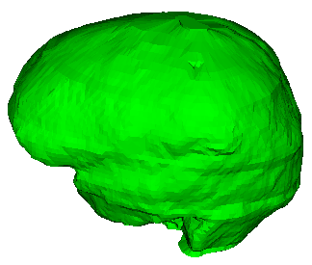

Data storage
Patient
Segmentation: MRML node, may contain multiple segments
Each segment contains multiple representations
Master representation:
Editable
All other representations are computed from this
Stored persistently
Segmentation
Segment - Brain
Brain (contour)
Segment - Tumor
Tumor (contour)

Slide 6
Conversion between representations
Driven by a dynamic graph
Nodes are the representations
Edges are the converters
Can be dynamically added
Can define representations
Cost metrics for edges
Automatic conversion follows cheapest path
Happens when an absent representation is requested
Ribbon
1.5
Contours
2.5
3.5
Binary image
2.5
Surface
2.0
2.0
Fractional image
4.0

Slide 7
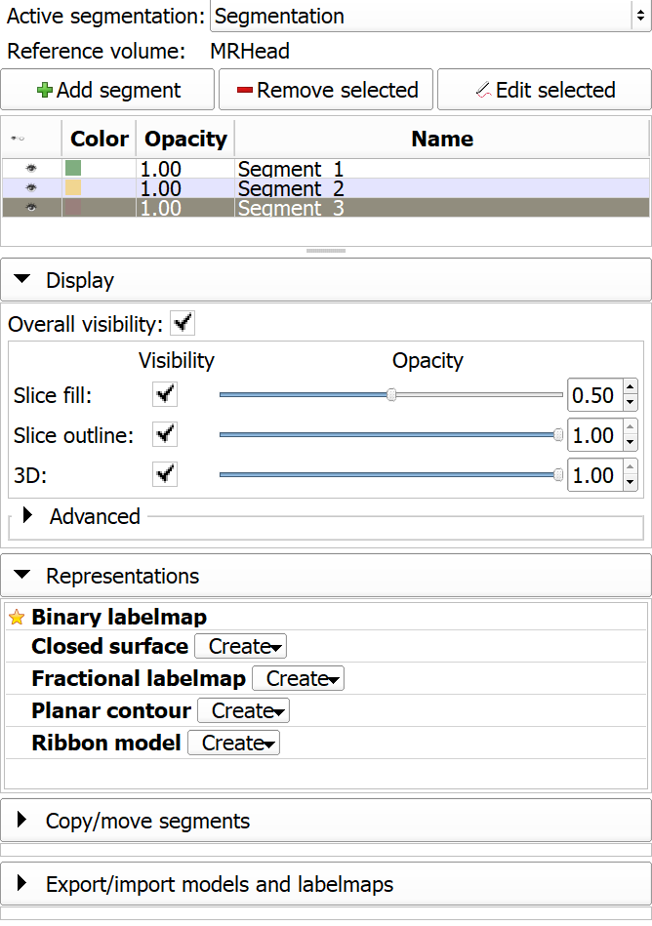
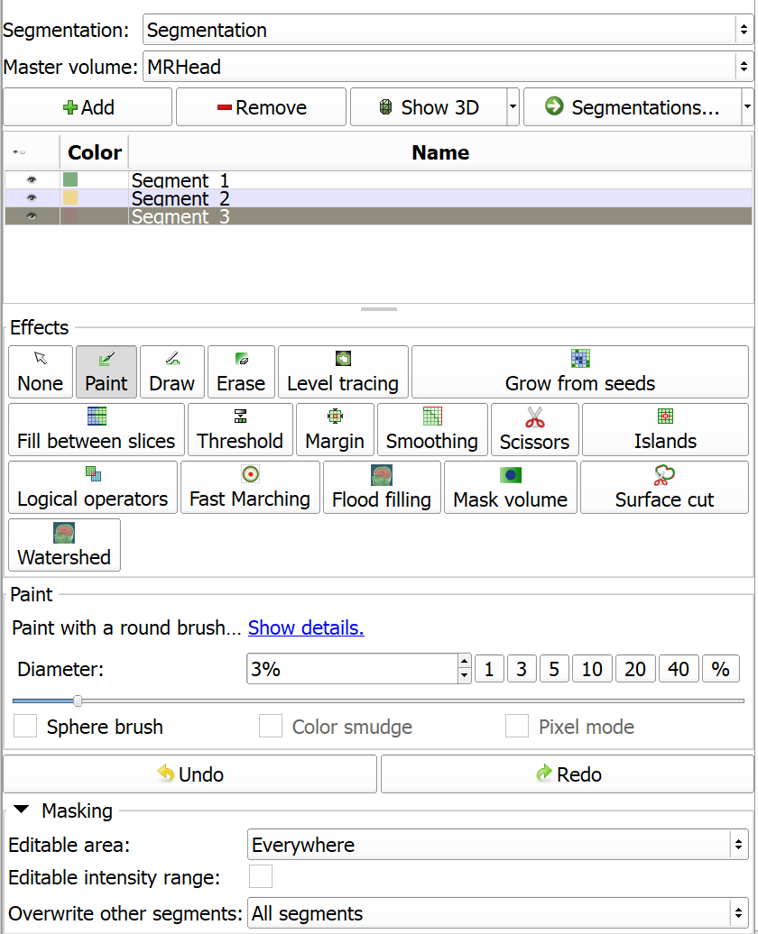
Slicer modules
Segmentations module:
Create/delete segmentation nodes
Create/delete/update representations
Edit display properties
Import from/export to different MRML nodes
Copy/move segments
Segment editor module:
Edit labelmap representation

Slide 8
Appendix

